Slide 1
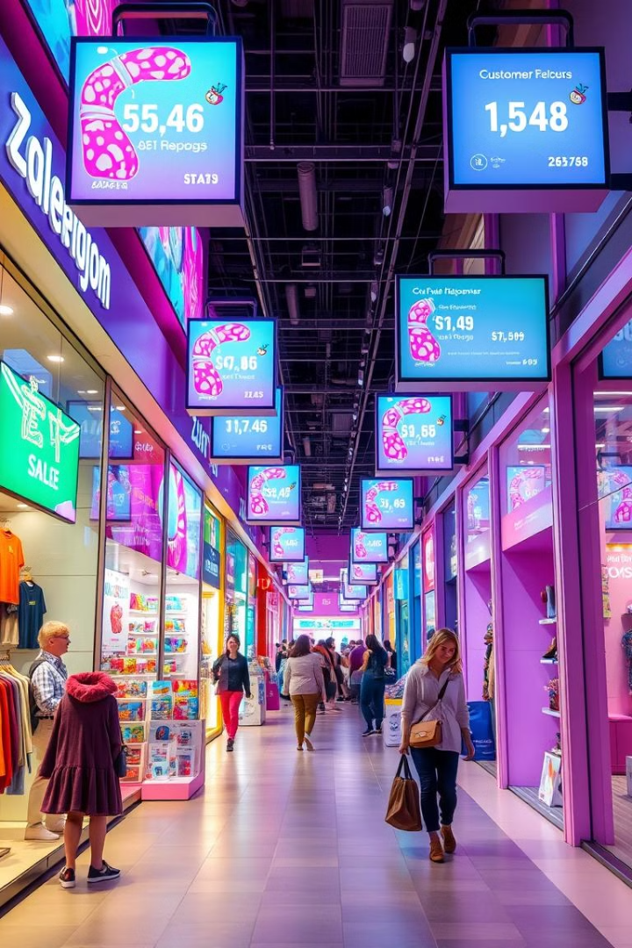

Sales Forecasting Across Multiple Retail Stores
In this project, I developed a sales forecasting model for multiple retail stores. I began by cleaning the dataset, which contained over 1 million records, addressing missing values, removing duplicates, and handling outliers. This preparation enabled me to analyze sales trends over time.
For exploratory data analysis (EDA), I uncovered insights about customer behaviour & sales performance, & engineered features related to dates, promotions, and competition.
In the machine learning (ML) part, I built the forecasting model using Sklearn pipelines with the Random Forest Regressor.
In the deep learning (DL) part, I conducted the ADF test to assess the stationarity of the time series data. Then Built the LSTM model using TensorFlow Keras with MLflow autologging. Created a Python file for a Streamlit dashboard that allows users to upload CSV or Excel files, displaying the last available date, a data preview, & generating six-week sales predictions along with a prediction & feature importance graph.
This project integrated data cleaning, EDA, ML & DL model building, and an interactive dashboard to provide a practical solution for sales forecasting.
by Debasis Baidya

Slide 2














Contributions of Key Libraries & Modules to the Project
NumPy, Pandas:
Matplotlib, Seaborn:
I used NumPy for efficient numerical operations & Pandas for data manipulation, which made handling large datasets straightforward.
I leveraged Matplotlib and Seaborn to create insightful visualizations, helping me uncover patterns in sales data during my exploratory analysis.
Logging, OS Module:
Sklearn, Scipy:
The Logging module helped me track the project's progress and debug issues, while the OS module managed file paths for data handling.
Sklearn provided tools for preprocessing and model evaluation, and Scipy offered essential statistical functions, which were vital for model development.
Statsmodels, Pickle:
TensorFlow, Keras:
I used Statsmodels for statistical analysis of sales data and Pickle to save my models, making it easy to load them later.
TensorFlow and Keras were crucial for building and training my LSTM model, allowing me to implement complex neural network architectures.
MLflow:
Streamlit:
MLflow helped me track experiments and manage the machine learning lifecycle, ensuring reproducibility in my model evaluations.
I used Streamlit to create an interactive web app for visualizing predictions, making it easy for stakeholders to explore the results.
Notes:
© Copyright PresentationGO.com – Free Templates & Infographics for PowerPoint and Google Slides

Slide 3
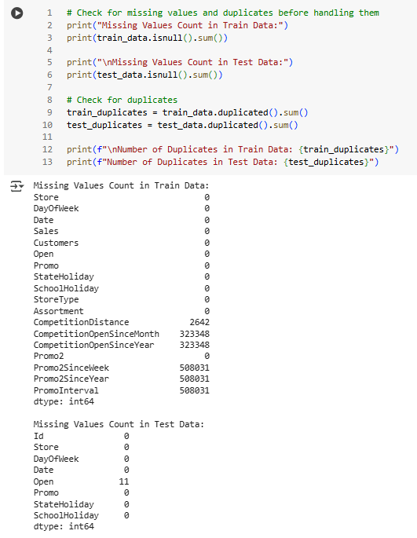
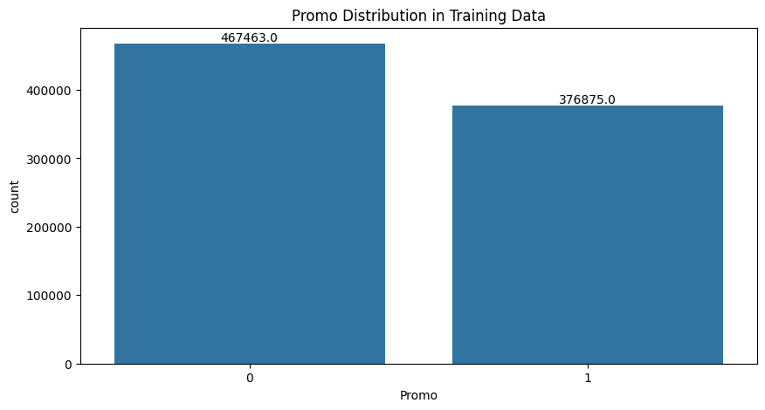
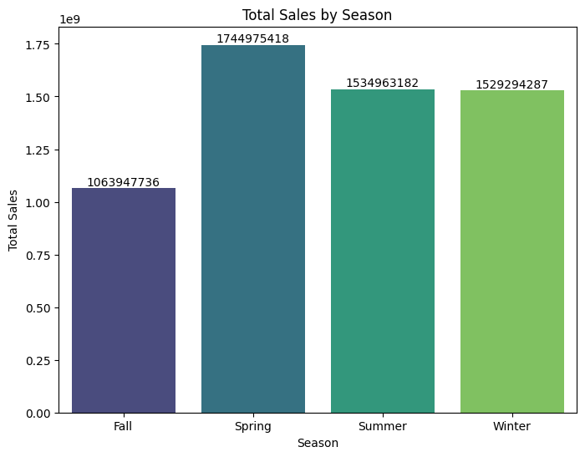
Data Exploration, Cleaning,
Processing Steps
1
Logging Configuration
I configured logging using Python's logging module to track the project's progress and errors, ensuring all important events were logged to a file for easy debugging.
2
Merging Train & Store Data
I merged the training dataset with store data during my exploratory data analysis (EDA) to better understand the relationships and patterns in the data.
3
Data Cleaning and Preprocessing
I focused on data cleaning and preprocessing to handle missing values, remove duplicates & standardize formats, ensuring the dataset was ready for analysis & modeling.
4
Feature Engineering
I performed feature engineering to create new variables from the existing data, which helped enhance the analysis during my exploratory data analysis (EDA).
5
Exploratory Data Analysis Visualizations
I plotted promo distribution, total sales by season, and sales distribution by promo etc.
These visuals helped me identify key patterns during my EDA.
6
Dropping Feature Engineering Columns
I dropped the feature engineering columns from the DataFrame to revert Train Data to its default state, ensuring a clean dataset for further analysis and modeling.

Slide 4
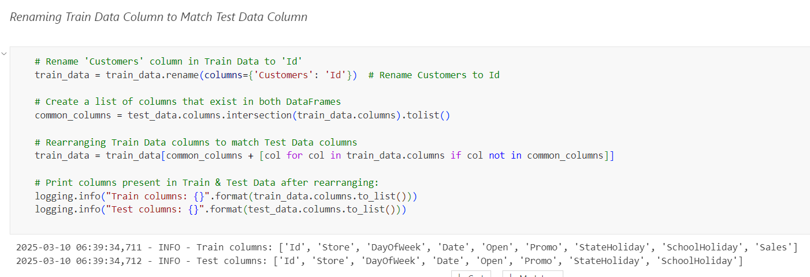
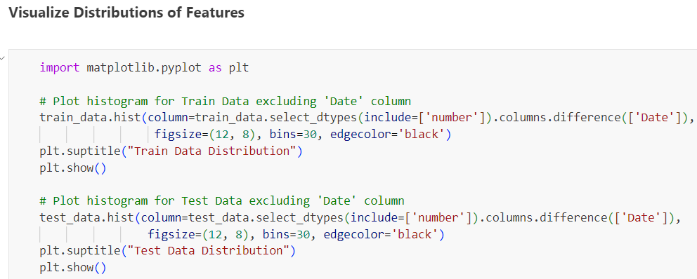
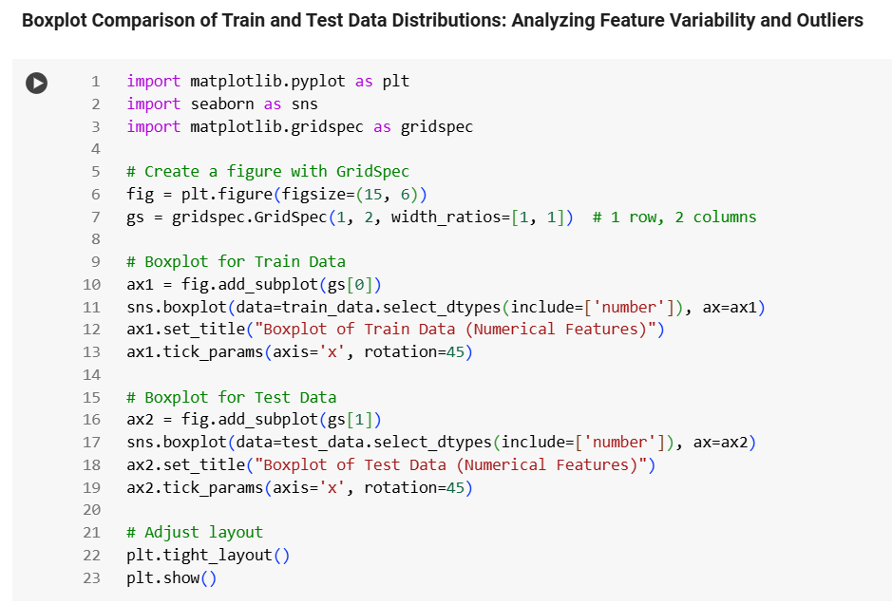
Data Preparation & Visualization
Summary
Renamed Customer Column
Visualized Distributions
of Features
Renamed the "Customer" column in the training data to “Id" to match the test data column.
Plotted distributions for various features to understand their characteristics.
Boxplot Comparison
Analyzed Feature Variability
Created boxplots to compare train and test data distributions, analyzing feature variability and outliers.
Assessed the spread of features across train and test datasets to identify differences.
Identified Outliers
Checked for Consistency
Used boxplots to pinpoint outliers that may influence model performance.
Ensured that the feature distributions were aligned between train and test datasets.

Slide 5
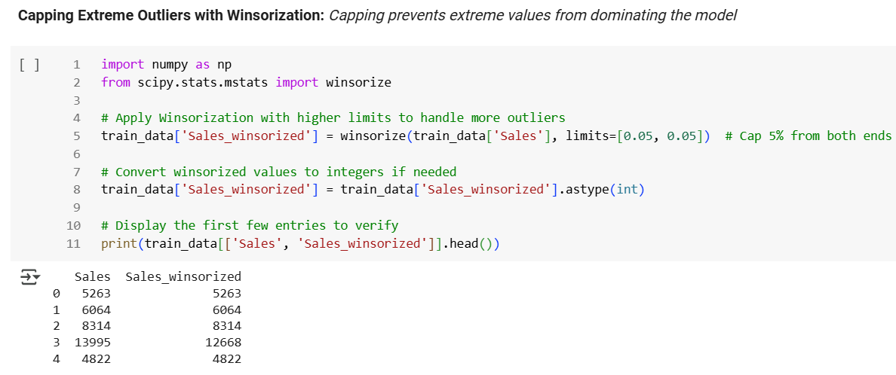

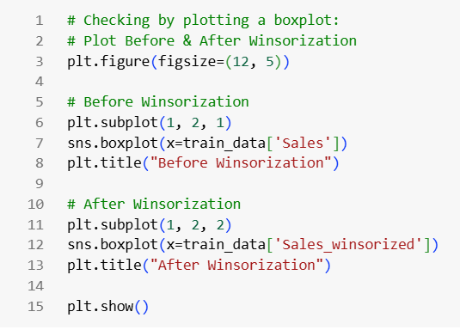


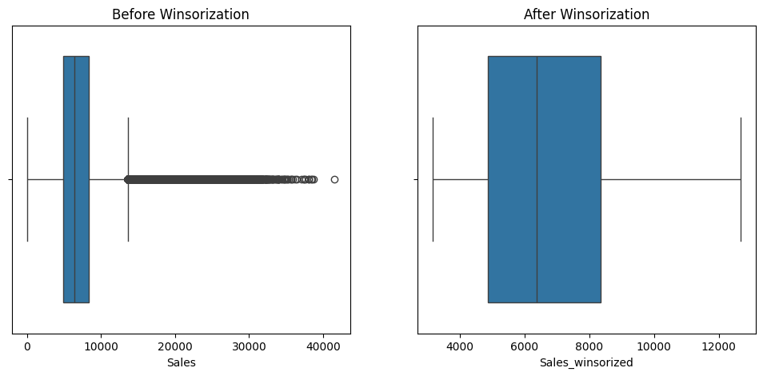
Winsorization of Sales Data
Outlier Treatment
Implemented Winsorization on the 'Sales' column to limit
extreme values, enhancing data robustness.
Data Integrity Check
Verified the transformation by displaying the original &
winsorized sales values side by side.
Comparative Visualization
Created boxplots to illustrate the difference in sales
distribution before and after Winsorization, highlighting
reduced variability.

Slide 6
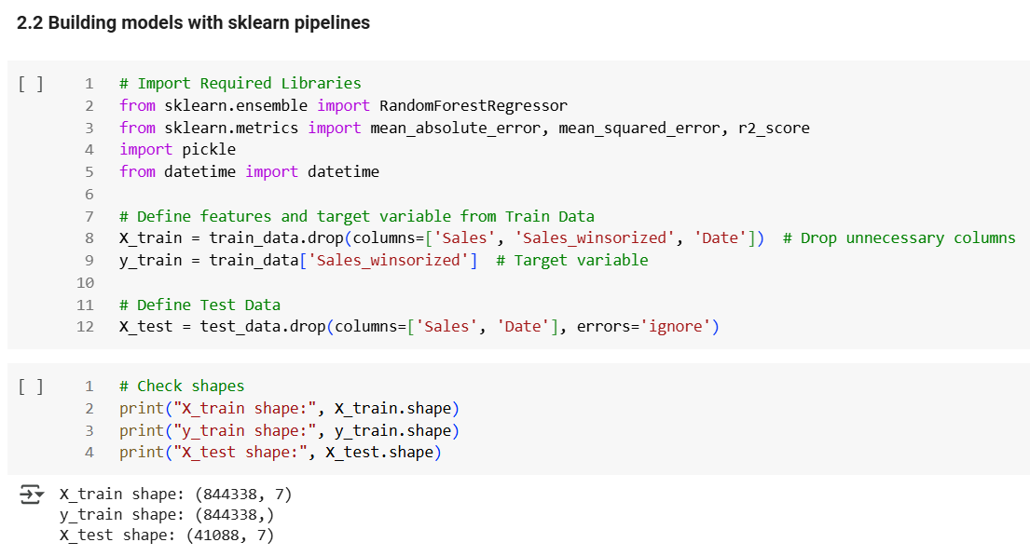
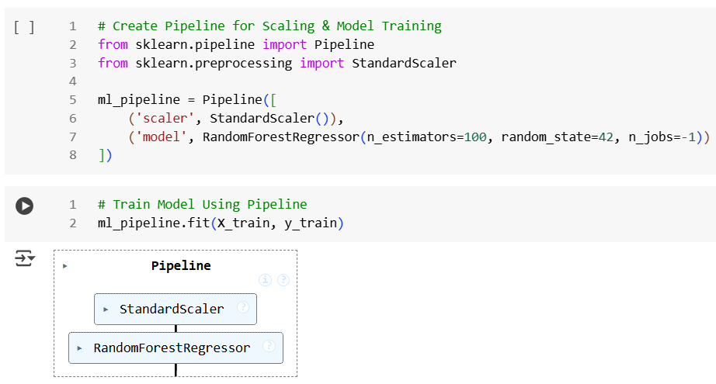
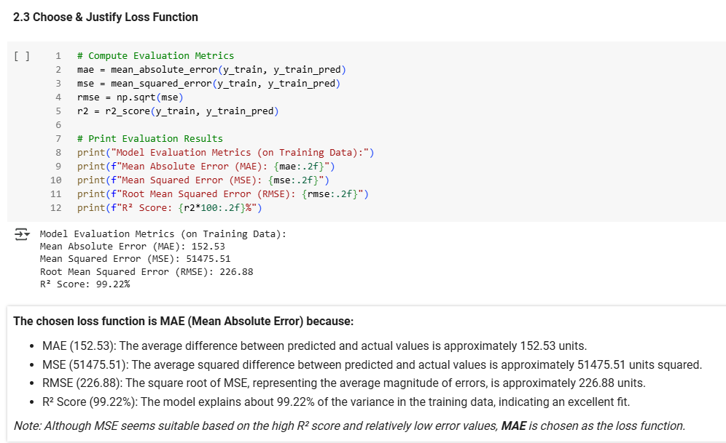
Model Training With Sklearn Pipeline
01
Pipeline Construction Built a Random Forest Regressor Pipeline to streamline the training process.
02
Feature Scaling Implemented feature scaling to normalize the input data, enhancing model performance.
03
Training Process
Trained the pipeline on the processed data, ensuring that it learned from relevant features.
04
Performance Evaluation Metrics Evaluated the model's performance using several metrics, including Mean Absolute Error (MAE), Mean Squared Error (MSE), and Root Mean Squared Error (RMSE).
05
Predictive Ability Achieved an R² Score of 99.22, indicating a strong predictive ability and excellent fit to the training data.

Slide 7
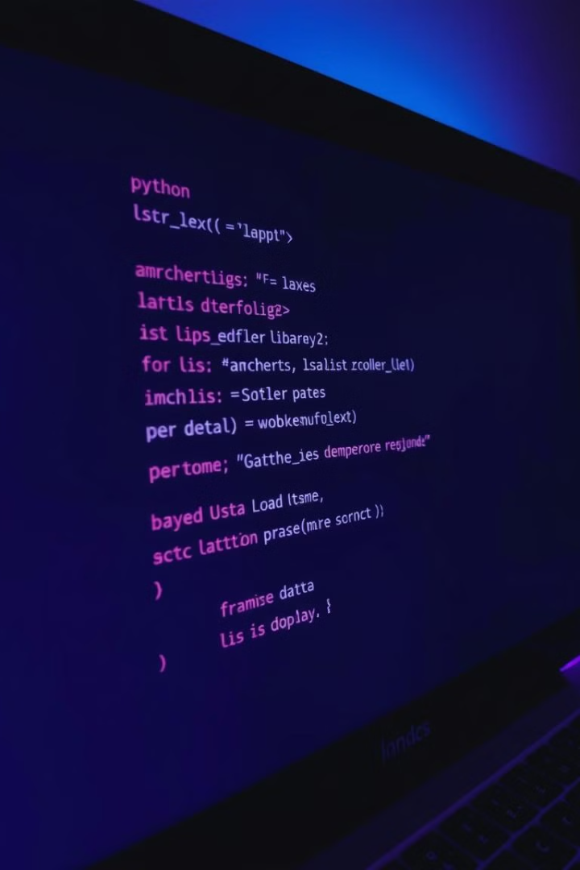
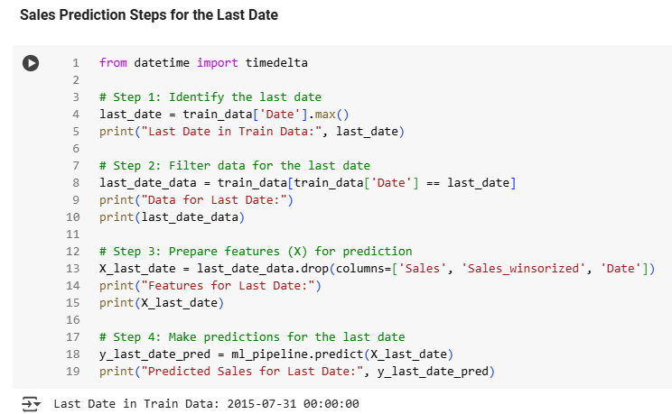
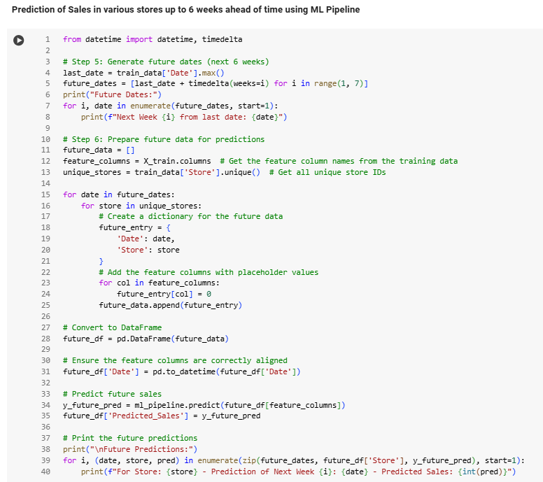
Predictions From The Last Date
To The Next 6 Weeks
1
Last Date Analysis
The last training date is July 31, 2015, with significant sales variability across stores, indicating diverse consumer preferences.
2
Sales Variability
Sales ranged from 4,822 to 27,508, highlighting the impact of location and store strategies.
3
Future Predictions
Store 0's future sales are consistently predicted at 3,174 for
the next 6 weeks, suggesting a stable baseline.

Slide 8
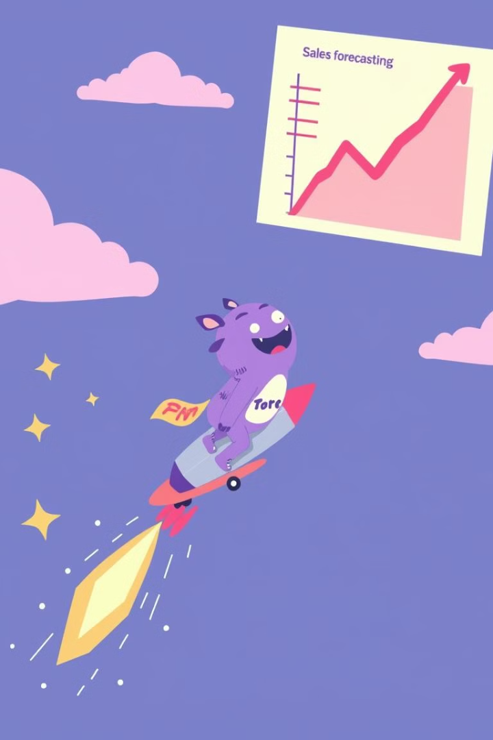
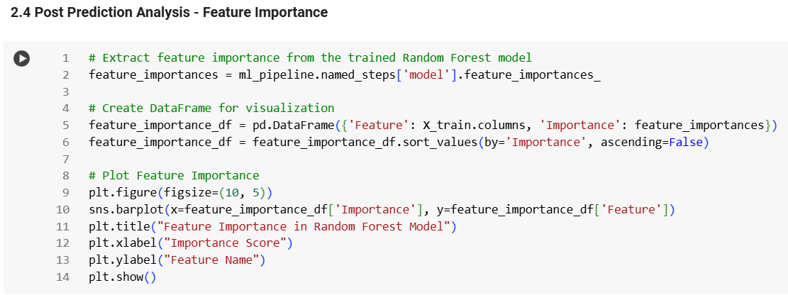

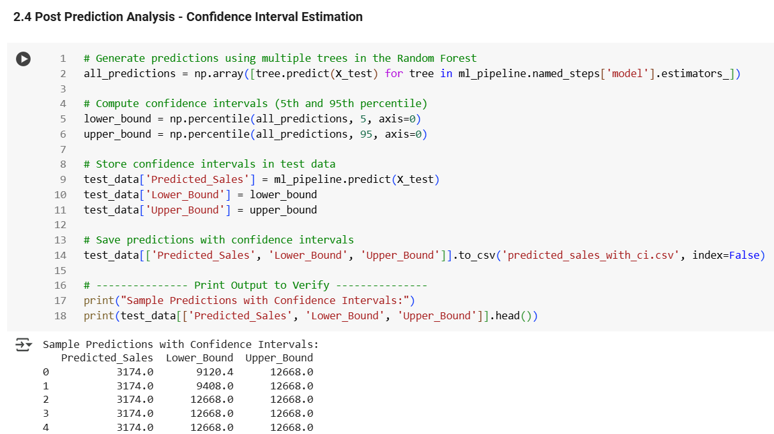



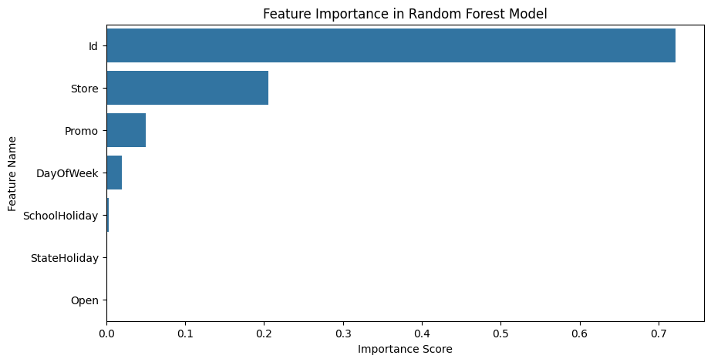
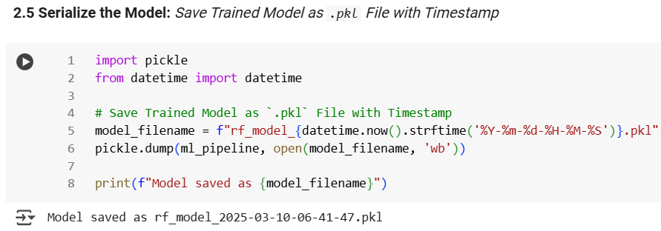

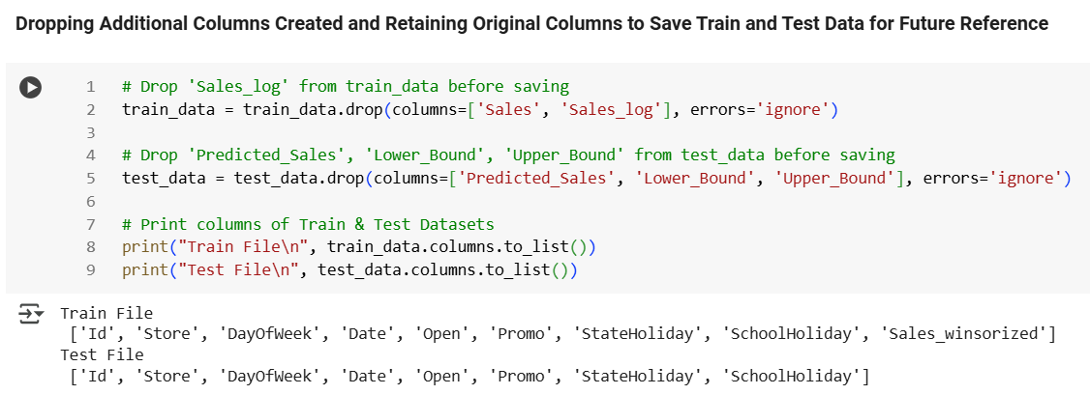

Post-Prediction Analysis
& Confidence Intervals
Feature Importance Analysis
Identified key predictors, with Store, Promo, and DayOfWeek having the
highest impact on sales.
Analysis & Confidence Intervals
Estimated confidence intervals (5th & 95th percentile) for predictions,
providing uncertainty estimates.
Model Serialization
Saved the trained model as a timestamped .pkl file for future deployment.
“rf_model_2025-03-10-06-41-47.pkl”.
Dropping Additional Columns
Dropped Unwanted Columns: Predicted_Sales (irrelevant for raw test data),
Lower & Upper_Bound (confidence interval bounds not needed for predictions).
Renaming "Sales_winsorized"
The column 'Sales_winsorized' in train_data has been renamed to 'Sales'.
Generated Files
train_file.csv (Processed Training Data)
test_file.csv (Processed Test Data)

Slide 9
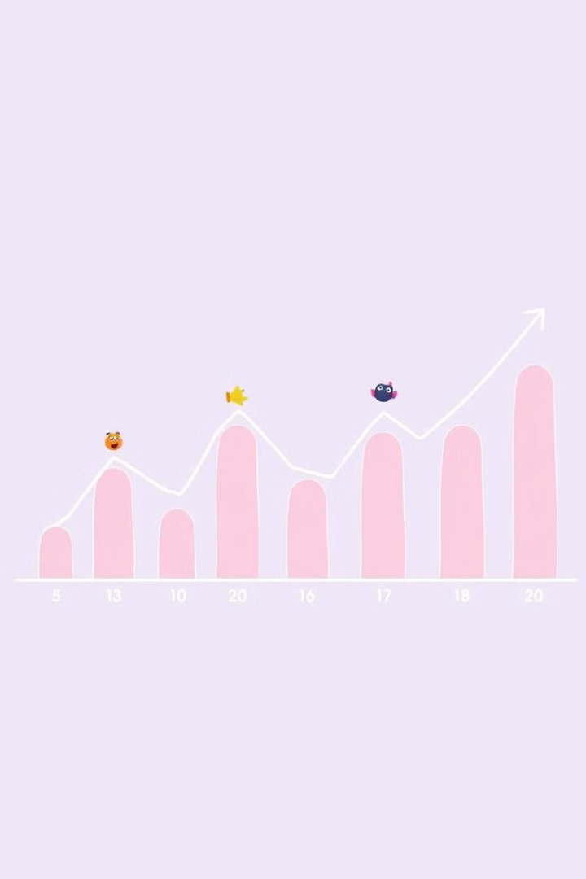
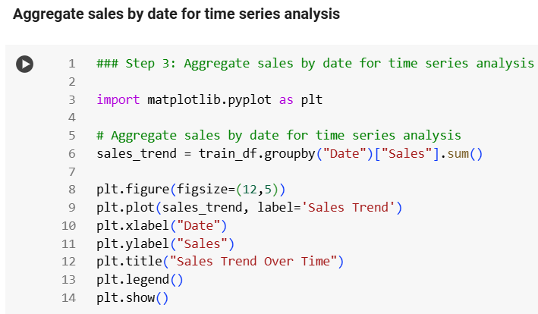
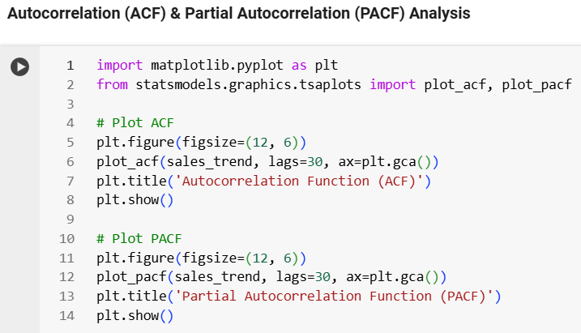



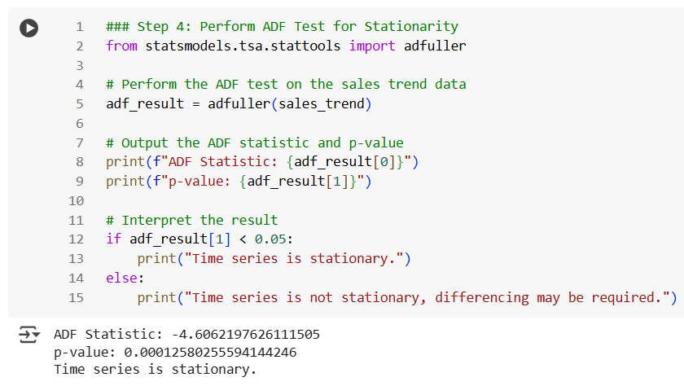



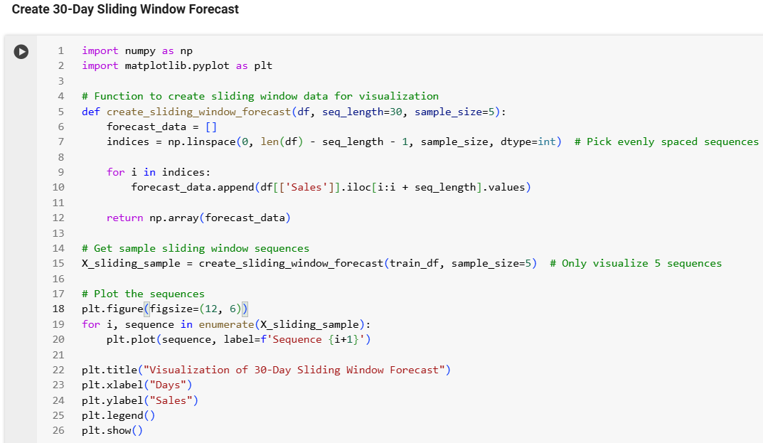
Time Series Analysis
Sales Trend
Stationary Data
ACF/PACF
Clear seasonal patterns with periodic peaks and drops.
ADF test confirms sales data is stationary (p-value: 0.0001).
Strong weekly seasonality (lags of 7, 14, 21, 28).
Residual Analysis
Decomposition
30-Day Sliding
Window Forecast
Examined residuals for heteroscedasticity and autocorrelation.
Identified trend, seasonal, and residual components.
Different sequences overlap, reflecting diverse sales patterns across various periods.

Slide 10

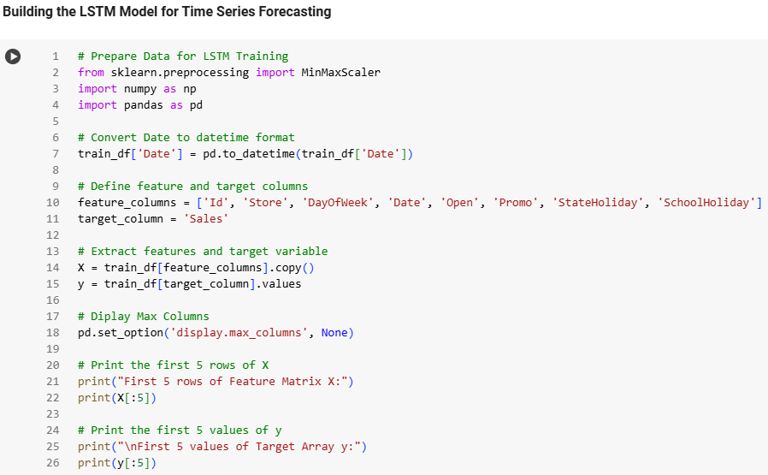
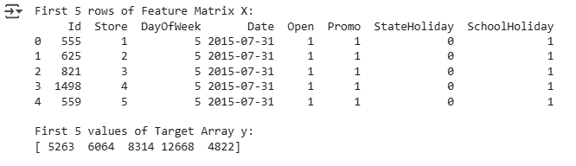
Building the LSTM Model
for Time Series Forecasting
Data Preparation
Selected Features
Converted 'Date' to numerical format (days since the first date).
Selected key features for LSTM training.
Features: ['Id', 'Store', 'DayOfWeek', 'Date', 'Open', 'Promo', 'StateHoliday', 'SchoolHoliday’]
Target: [‘Sales’]
Key Takeaways
Conclusion
Date conversion is crucial for LSTM.
Diverse features enhance model performance.
Features: ['Id', 'Store', 'DayOfWeek', 'Date', 'Open', 'Promo', 'StateHoliday', 'SchoolHoliday’]
Target: [‘Sales’]

Slide 11

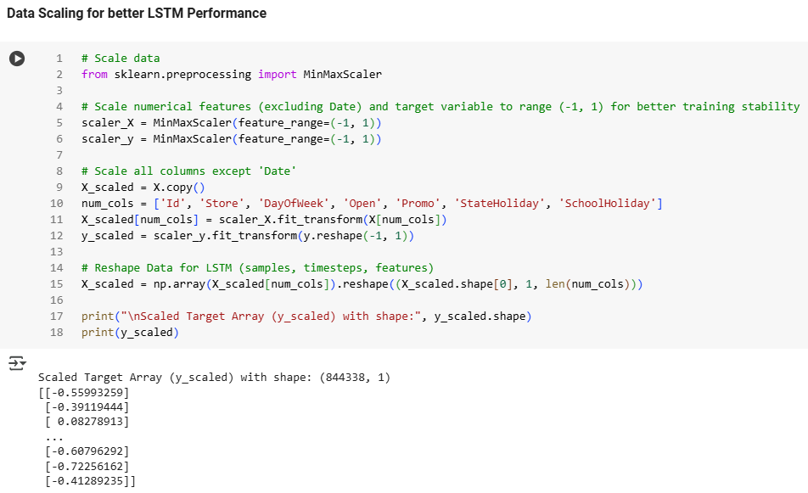
Data Scaling for Better
LSTM Performance
Purpose of Scaling
Scaled numerical features and target variable to a range of -1 to 1 using MinMaxScaler.
Scaling Process
Created two MinMaxScaler objects: scaler_X: For numerical features. I scaler_y: For target variable (y).
Applied Scaling to Numerical Columns
Id, Store, DayOfWeek, Open, Promo, StateHoliday, SchoolHoliday.
Excluded the Date column from scaling.
Reshaped Scaled Input Data
Reshaped scaled input data (X_scaled) to the format required by LSTM: (samples, timesteps, features)
Outcome
Numerical features and target variable successfully scaled to -1 to 1.
Input data reshaped for LSTM training.
Conclusion
Scaling improves stability and efficiency of LSTM training.
Ensures all features and target variables are on the same scale, enhancing the model's learning process.

Slide 12

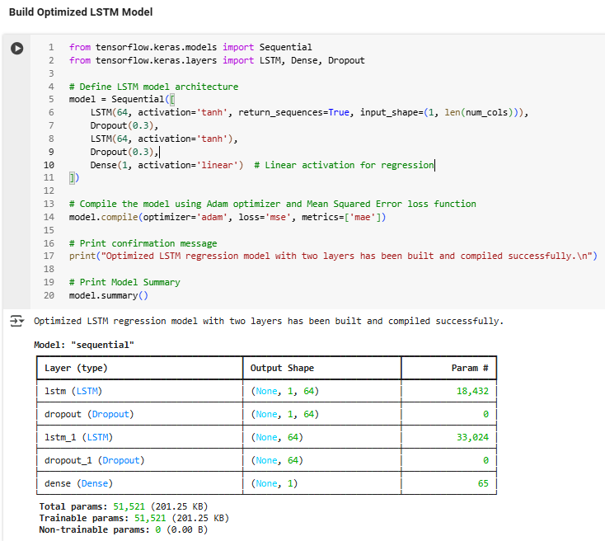
Build Optimized LSTM Model
Model Framework
STEP
01
Utilized Sequential model from TensorFlow Keras.
Layer Implementation
STEP
02
First LSTM Layer:
64 units
Dropout (30%) to mitigate overfitting.
Second LSTM Layer:
64 units
Dropout (30%)
Output Layer
STEP
03
Dense layer with linear activation for regression tasks.
Model Compilation
STEP
04
Optimizer: Adam for efficient training.
Loss Function: Mean Squared Error (MSE) for regression.
Model Summary
STEP
05
LSTM Layer 1: (None, 1, 64) | Params: 18K | Dropout 1: (None, 1, 64)
LSTM Layer 2: (None, 64) | Params: 33K | Dropout 2: (None, 64)
Dense Layer: (None, 1) | Params: 65 | Total Parameters: 52K
Conclusion
STEP
06
Optimized LSTM regression model designed to capture sequential patterns while minimizing overfitting. 🚀

Slide 13
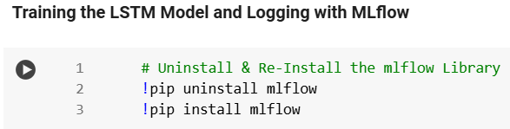
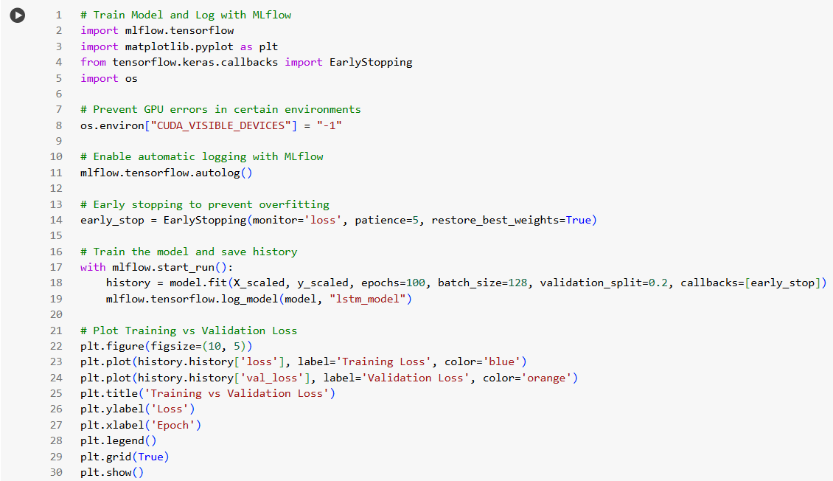
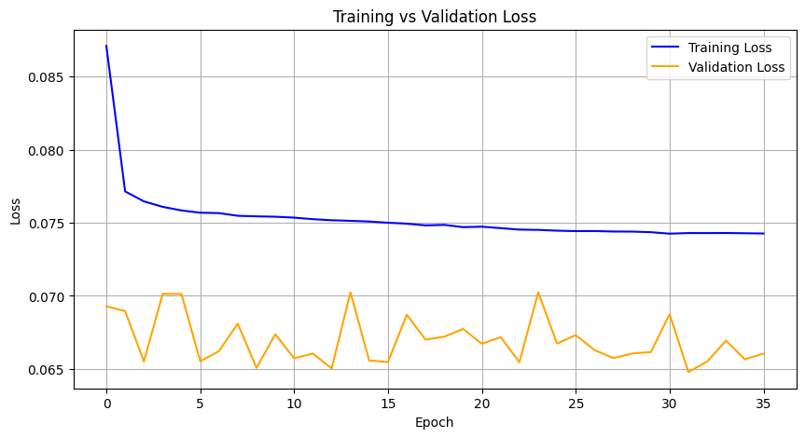
LSTM Model Training
& MLflow Logging
01
Model
LSTM for future sales prediction using time series data.
02
Tracking
Utilized MLflow autologging for performance metrics.
03
Key Techniques
EarlyStopping (patience = 5) to prevent overfitting.
Disabled GPU: os.environ["CUDA_VISIBLE_DEVICES"] = "-1".
Trained for 100 epochs, batch size of 128, 20% validation split.
04
Outcomes
Training Loss: Decreased steadily; final: 0.0743 (MAE: 0.2110).
Validation Loss: Stabilized after initial fluctuations; final: 0.0660 (MAE: 0.1970).
Analysis
Training Curve: Smooth decline, indicating effective learning.
Validation Curve: Initial spikes but overall stabilization, suggesting good generalization.
05
06
Key Takeaways
✅ Effective learning with minimal overfitting.
✅ Minor validation fluctuations are expected but manageable.
07
Conclusion
LSTM model captured sequential patterns well; training logged with MLflow for reproducibility. 🚀

Slide 14
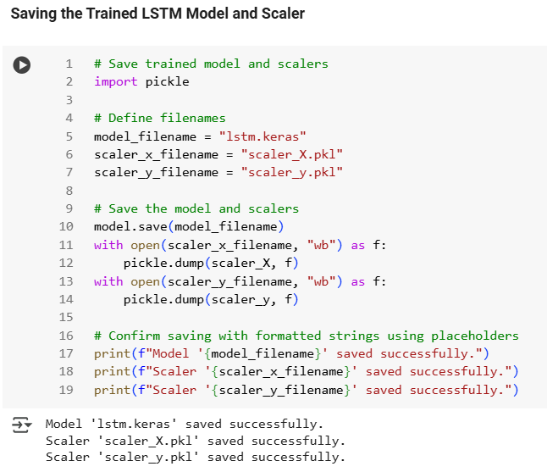
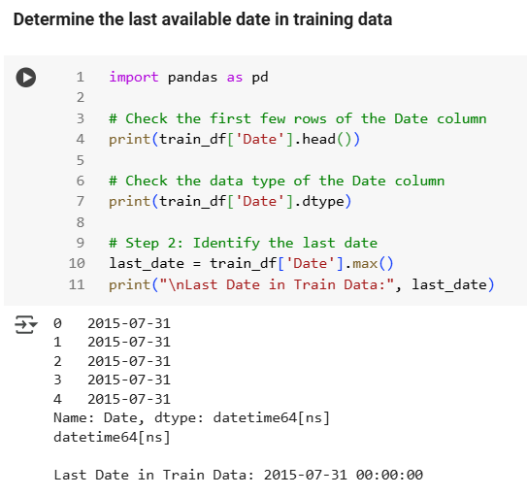
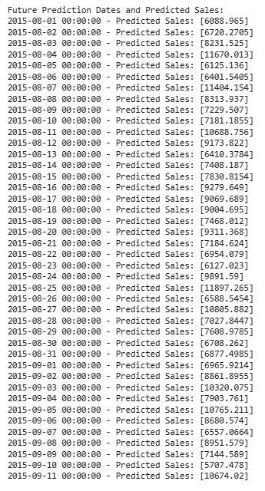
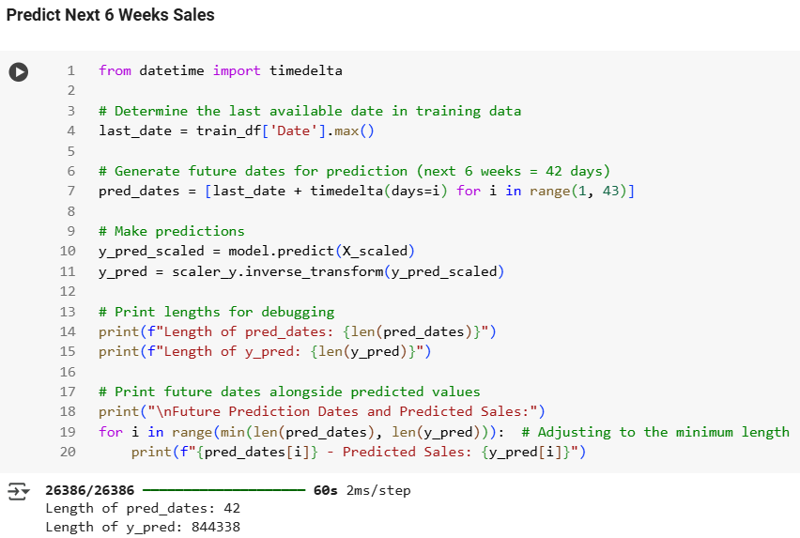
Determining Last Available Date
& Saving the Model & Scaler
Overview
Developed an LSTM model to predict future sales based on
historical data.
Model & Scaler Saving
Saved LSTM model as lstm.keras.
MinMaxScaler objects saved as scaler_X.pkl and scaler_y.pkl
Last Training Data Date
Last available date in training data is: 2015-07-31

Slide 15

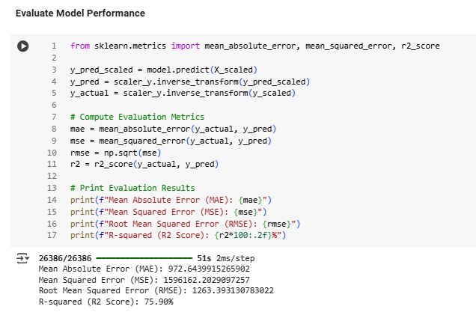

FUTURE PREDICTIONS
PERFORMANCE METRICS
KEY TAKEAWAYS
Generated dates for the next 6 weeks (42 days): from 2015-08-01 to 2015-09-11.
Predictions scaled back to original values.
MAE: 972.64
MSE: 1,596,162.20
RMSE: 1,263.39
R² Score: 75.90%
Model explains 75.90% of variance; reasonable error margins.
Ready for future sales forecasting. 🚀

Slide 16
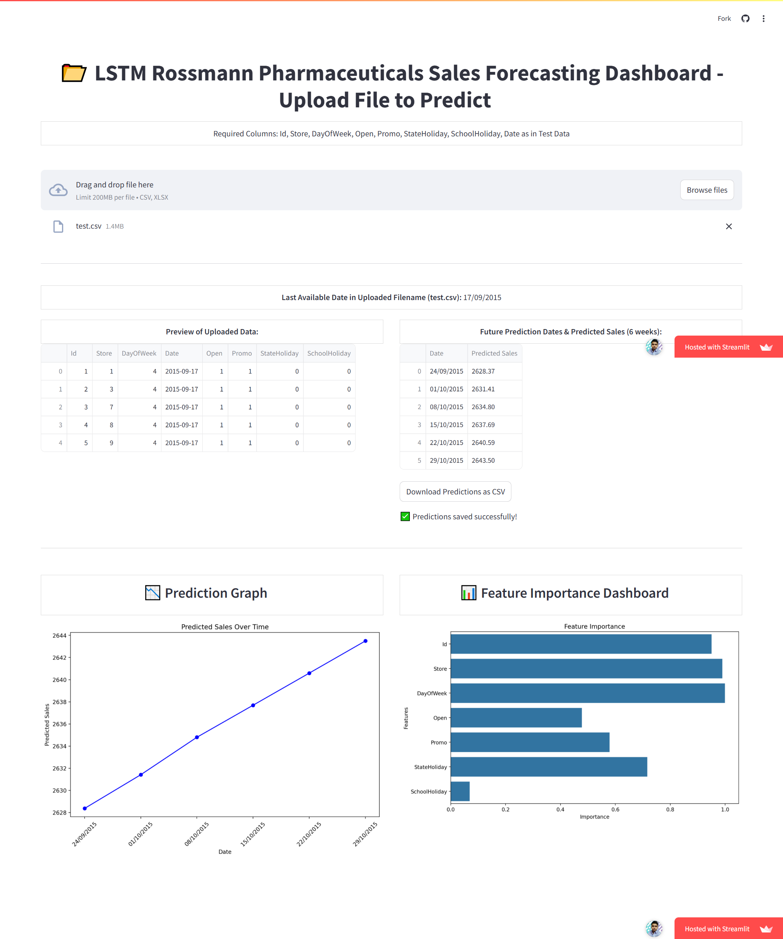
Interactive Sales Forecasting
with Streamlit and LSTM
1
Dashboard Overview
Developed & Deployed an interactive dashboard for
forecasting sales using LSTM neural networks
& Streamlit.
Technologies Used
2
Streamlit: Web app framework for user interface.
Pandas: Data manipulation and analysis.
NumPy: Numerical operations.
TensorFlow/Keras: LSTM model handling.
Scikit-learn: Data preprocessing (MinMaxScaler).
Matplotlib & Seaborn: Data visualization.
MLflow: Model tracking and management.
3
Key Features
Last Most Recent Date: Displays initial rows for user verification.
Uploaded Data Preview: Shows the latest date in the dataset.
Predictions Download as csv: Option to download predictions as CSV.
Prediction Graph: Visualizes predicted sales trends.
Feature Importance Dashboard: Displays feature importance.
User Interface
4
Clear instructions for users regarding data requirements.
Intuitive layout with separate sections for data preview, predictions,
and visualizations.

Slide 17

I appreciate your time and attention. 😊
I hope this presentation was informative and helpful.
Please don't hesitate to contact me with any questions or feedback you may have.
I am more than eager to hear your thoughts and suggestions. 🙂

